Slide 2
Pre-Presentation FlAixEnergy applied Loadflow with Python
Wednesday, August 22, 2018

Slide 3
Overview
Loadflow
Pandapower
Tkinter GUI
Package Distribution

Slide 4
1. Loadflow
Newton-Raphson Method
Equations
Optimization
Costs
Line Loading

Slide 6
2. Pandapower
Anaconda:
I used the Anaconda environment to run Spyder (it also has Jupyter, VS Code, etc and I didn’t know if I was going to used Visual Studio to begin with)
I used Anaconda Prompt to install packages throu pip
pip install <your module>
Spyder:
Variable Explorer
Run multiple instances in one
Easier to set environment and to import packages

Slide 8
3. Tkinter GUI
Overview:
Code Structure
Environment

Slide 9
Environment
PyCharm (Python IDE)
To read, test, maintain, and evolve the code
It highlights code with PEP8 warnings.
It helps to do refactoring (changing variable’s or template’s name)
It suggests variables, classes, etc →IntelliSense/Code Completion (great for either built-in or external packages) and Python Type Hint → good for both health and speed
Git visualization in the editor (I didn‘t use this feature tho)
Package management → Nice visual representation of what‘s installed (yes, we can always use pip)
Good Debugger

Slide 10
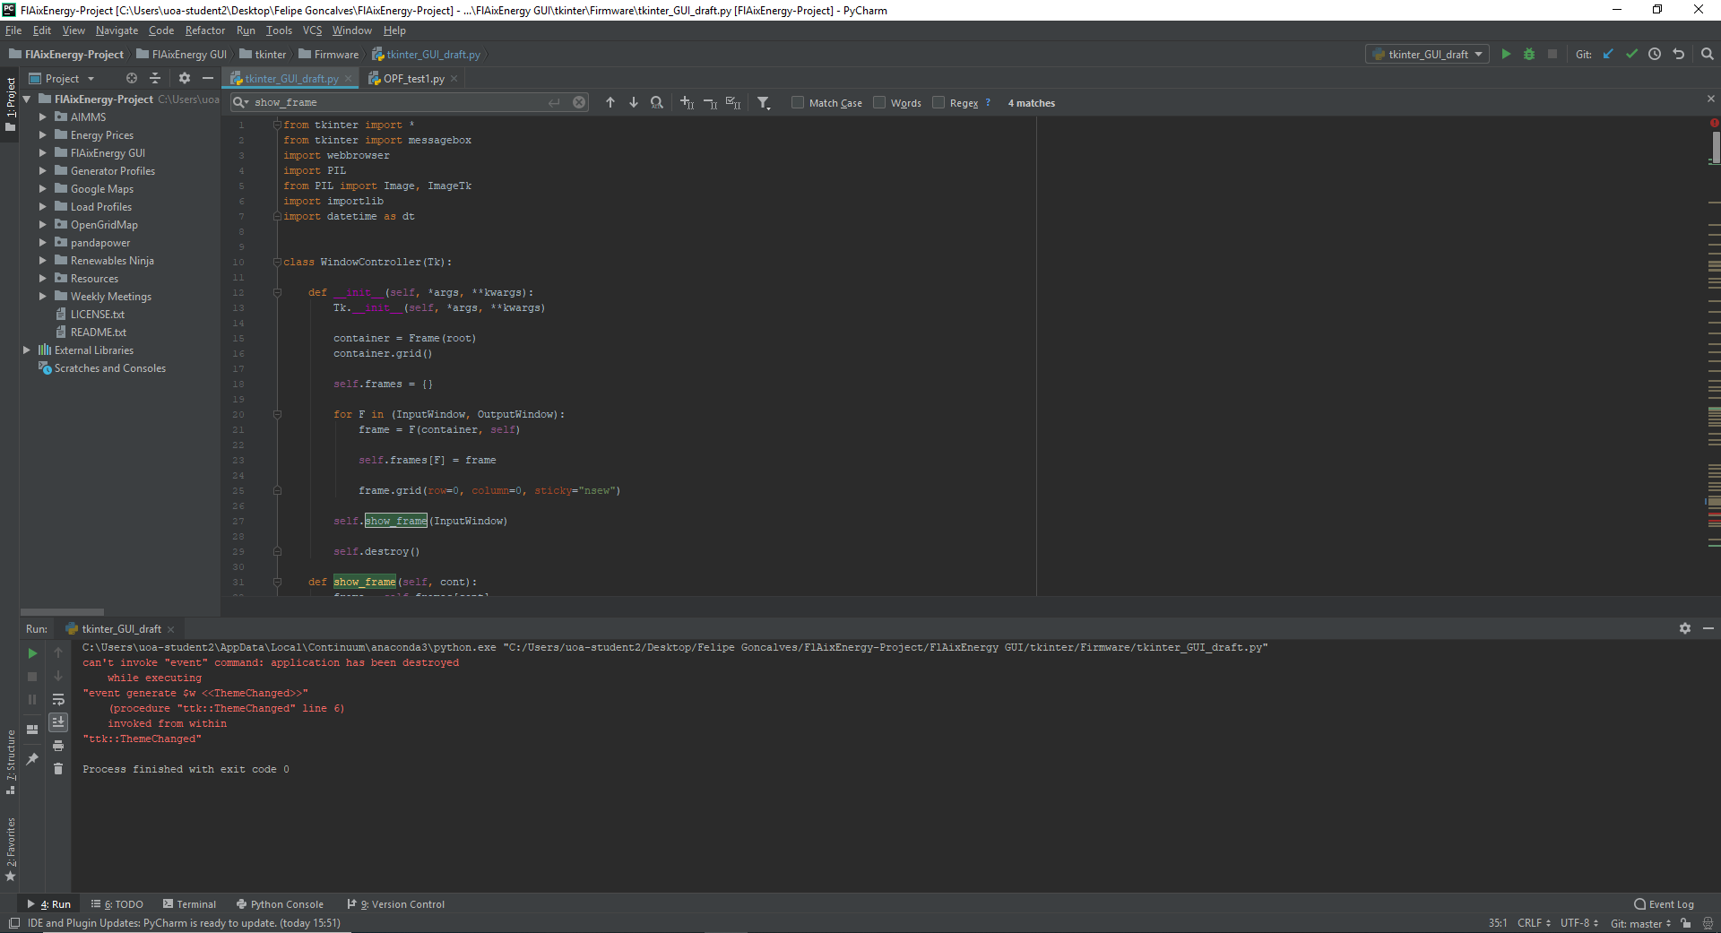
Environment
JetBrains PyCharm Community Edition 2018.1.3 x64

Slide 11
Code Structure
Import packages
Define classes (Windows)
Initialize instance of a class
def __init__(self, parent, controller):
Create frame
Add widgets under grid
Define functions used in the widgets
Generate root
Initialize variables
Create main loop using classes
Structure based on https://stackoverflow.com/questions/14817210/using-buttons-in-tkinter-to-navigate-to-different-pages-of-the-application

Slide 12
Classes
Window Controller
Define show_frame()
Welcome Window *
Input Window
Output Window
* can be added later

Slide 13
4. Package Distribution

